Slide 1


Fundamentals of RM
RM System and Process
Leadership in RM
Incident Investigation
RM Tools & Challenges
RM in Industry
People & Org.
Application and Perspectives
On Becoming a
Leader in Risk Management
ENGG404 - Lecture
Expectations, Preparation, and Instructions For
Writing the Final Exam

Slide 2

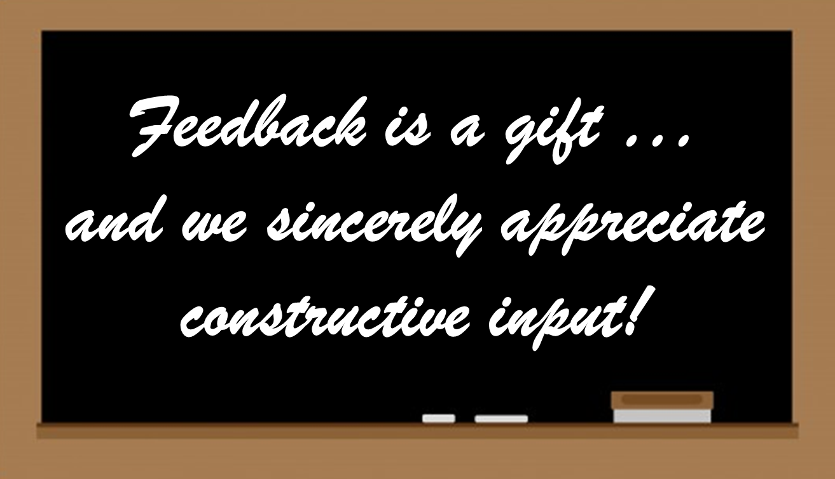
REMINDER – USRI Survey is OPEN!
We know it is a very busy time of year for you … but in the spirit of program evaluation and continuous improvement, we ask you to take the time to respond on USRI.
Your comments and constructive feedback guide us in making improvement to the course.
Thank you!
Expectations and Instructions For Writing the Final Exam
‹#›
Notes:
‹#›

Slide 3

Purpose and Learning Outcomes:
Purpose:
Communicate the expectations for academic integrity.
Communicate details about the Final Exam.
Help you prepare to write the Final Exam.
Sections in this Presentation:
Reduce Exam Anxiety
Academic Integrity and Ethical Conduct
Final Exam Day, Time, and Location
Final Exam Parameters and Format
Final Exam Content and Your Preparation
Key Points about Writing the Exam:
Learning Outcomes – At the end of this topic, you will be able to:
Explain the academic integrity expectations and what it means to you.
State and explain details about the Final Exam.
Find answers to your questions about the Final Exam.
PPT posted on ENGG404 Student Resources Shared Drive.
As such, minimal time will be spent on the slides except as noted.
A slide with a check – spend time on this; otherwise all other slides are for reference.
Expectations and Instructions For Writing the Final Exam
‹#›
Notes:
‹#›

Slide 4
Reduce Exam Anxiety!
We know that:
Students face anxiety in preparing for and writing a
final exam …
And this anxiety may tempt students to “cheat” on the final exam
So, to reduce anxiety:
We communicate as much as possible about the final exam: the format and mechanisms, and to an extent, the content.
We format the exam to make it challenging to “share” (cheating through collusion by communicating with each other during the exam) i.e. “level the playing field for all” and knowing it is difficult for everyone, this removes further temptation to cheat.
The outcome of these actions:
Reduces student anxiety;
Eliminates the temptation to cheat;
Sets the foundation for academic integrity.
Expectations and Instructions For Writing the Final Exam
‹#›
Notes:
‹#›

Slide 5
Final Exam Location:
Location for Writing:
In previous years, the final exam was written at LAC (proctored, authorized materials only).
This term, as was the case for 2020S, 2020F, 2021W, 2021S, and 2021F terms, the final exam will not be on-campus at LAC, so essentially this means that you, the students, will be able to write the exam at any location of your choosing and use any materials available to you:
  Comfortable space – light, temperature, seating, accessibility
  Set-up for no interruptions (let your family members know)
  Reliability: computer power supply and internet access
  ExamLock will NOT be used
  No on-line proctoring system will be used
Expectations and Instructions For Writing the Final Exam
‹#›
Notes:
‹#›

Slide 6
Academic Integrity and Ethical Conduct:
A Message from Professor Winkel, Director, Chair, ESRM School:
Thank you for your continued study and efforts on your journey to becoming a
professional engineer, a journey where we have provided a framework in risk
management and leadership to support you in your future career. Working as a
professional engineer, society trusts and respects that your contributions are
grounded in high standards not only of technical expertise but also of ethical conduct. As you have learned in this course, one of these standards is that all of our endeavours are carried out with a full regard for safety and risk management to protect society from harm and loss.
Another ethical standard concerns honesty and integrity in our efforts. As engineers, we are credited with conducting our affairs so that our representations are a true reflection of our knowledge and capability. We expect the same high standards from you as you prepare to demonstrate your learning in risk management through writing the final exam. As a future engineer now working through your studies, the expectation for honesty and integrity in your conduct also applies here.
We are committed to supporting your success as a professional engineer, and you have the opportunity to demonstrate integrity in this exam activity.
All the best.
Expectations and Instructions For Writing the Final Exam
‹#›
Notes:
‹#›

Slide 7
Academic Integrity and Ethical Conduct:
The Final Exam paper is:
“Confidential and Copyright Protected – Do NOT Share”.
You will be asked to confirm your understanding of the academic
honesty statement:
I understand that it is important that the quiz (final exam) attempt I am about to make is all my own work. I understand what constitutes plagiarism or cheating, and I will not undertake such activities. The University of Alberta is committed to the highest standards of academic integrity and honesty. I understand the Code of Student Behaviour and am aware that all forms of academic misconduct will be addressed.
You are expected to abide by the University Academic Integrity Policies and maintain academic integrity and honesty within these “Acceptable” and “Not Acceptable” boundaries: (next page)
Expectations and Instructions For Writing the Final Exam
‹#›
Notes:
‹#›

Slide 8
Academic Integrity and Ethical Conduct:
ACCEPTABLE DURING THE FINAL EXAM:
Using your lecture notes, ENGG404 Student Resources
shared drive, ENGG404 eClass content, the course textbook.
NOT ACCEPTABLE :
Sharing or discussing your final exam questions and answers with others during the final exam time frame or after you have written the final exam.
Taking images (screenshots, photographs, videos) of the Final Exam.
Posting any final exam questions and answers with the intent to make these available in the private domain or public domain, during or after the final exam time frame.
Accessing any content from the Final Exam that is posted on-line.
Working with others, students or any other person, during the final exam time frame.
All unacceptable actions are acts of academic dishonesty (cheating),
a serious academic offence that can result in suspension or expulsion from the University.
Expectations and Instructions For Writing the Final Exam
‹#›
Notes:
‹#›

Slide 9
Academic Integrity and Ethical Conduct:
Q: Are you thinking about asking for help from a class-mate
or from any other person?
Q: Are you thinking about offering to help by sharing questions
and your responses to help a class-mate?
A: DON’T! Let me explain what this means to you …
Ethical conduct in the profession and our academic integrity.
  Both “asking” or “offering” to help are unacceptable actions that violate the Student Code of Conduct, and are contrary to both our ethical conduct in the engineering profession and our academic integrity.
  Both acts are cheating.
You may be helping your friend at your expense!
  The separation between two letter grades
  is minimal!
  Your “help” may push that other person up a
  couple of percentage points, and push your
  letter grade lower!
Expectations and Instructions For Writing the Final Exam
‹#›
Notes:
‹#›

Slide 10
Final Exam Day and Time:
Day and Time for Writing:
The final exam will be administered on-line through eClass, much the same manner as the quizzes and assignments, at the fixed day and time of Wednesday 27-April-2022.
  Opens at 9:00AM MT (University Time)
  Closes at 12:00PM NOON MT (University Time)
  Those with conflicts have been notified. If you have NOT confirmed
  the alternate day and time, or have NOT been notified,
  please contact Professor Cocchio immediately.
  Those with accommodations have been notified. If you have NOT received confirmation of your accommodations, please contact Professor Cocchio.
Cocchio@ualberta.ca
  The University is not offering an accommodation for students (in vastly different time zones) to complete their final exams during daylight hours no matter their location.
Expectations and Instructions For Writing the Final Exam
‹#›
Notes:
‹#›

Slide 11
Final Exam Parameters and Format:
The Final Exam will be administered in three (3) segments.
Before Each Segment Starts and After Each Segment Ends:
Segments will NOT be accessible until the “OPENS AT” time.
Each segment will end at the “CLOSES AT” time.
  All responses will be logged when you “FINISH ATTEMPT” or automatically logged at the “CLOSES AT” time.
  Time not used in a previous segment will NOT be carried forward to a subsequent segment.
  After the Final Exam finishes, congratulate yourself on your efforts, and take some time to relax and enjoy!
Expectations and Instructions For Writing the Final Exam
‹#›
Notes:
‹#›

Slide 12
Final Exam Parameters and Format:
Final Exam Format:
The duration of the three (3) segments are based on marks allocated (likely unequal duration, per Assignments #3 and #4).
Overlap of 5 minutes allows for sign-off / sign-on to each segment.
You will be allowed a full 180 minutes + 5 minutes in total
Exception: If you start a segment too late after it opens because each segment has a hard “CLOSES AT” time.
Note that eClass will automatically log any and all responses at the close of each segment.
Expectations and Instructions For Writing the Final Exam
‹#›
Notes:
‹#›

Slide 13
Final Exam Parameters and Format:
Exam Parameters Common to All Segments:
When time expires: Open attempts are submitted automatically
Attempts allowed: 2
You have two (2) attempts within the OPEN-CLOSE time-frame:
Helpful in event of any internet connectivity interruption. If you are interrupted, then go into the exam to start a second attempt.
Your previous work (most / all of it) will be there.
Instructions for additional contact help will be given on the
day of the final exam.
Each attempt builds on the last: Yes
Graded on: “Last Attempt”
Require students to accept academic honesty statement:
Yes, students must acknowledge the academic honesty statement.
Expectations and Instructions For Writing the Final Exam
‹#›
Notes:
‹#›

Slide 14
Final Exam Parameters and Format:
Exam Parameters Specific to Each Segment
(knowing these parameters in advance helps you manage your time):
Segment #
Opens at (time)
Closes at (time)
“Free Navigation” (select any question) or “Sequential” (no going back)
Total Marks
Weight on Final Grade
(Total = 55% for all segments)
Planned duration
List of Question #’s and Marks for each question
Expectations and Instructions For Writing the Final Exam
‹#›
Notes:
‹#›

Slide 15
Final Exam Parameters and Format:
Exam Parameters Specific to Each Segment:
The final exam consists of these timed segments.
Note that there is a 5-minute overlap between the segments.
This is to allow for your sign-off and sign-on, and any brief break
you may wish to take.
The Table of Parameters listed below is for the 2021F Final Exam and may change for this Final Exam.
Segment | Opens | Closes | Number of Questions | Total Marks | Final Grade Weight | Allotted Time (mins) | Navigation Method
1 | 9:00AM | 10:12M | 22 | 97 | 20.5% | 67 | FREE
2 | 10:07AM | 11:20AM | 25 | 97 | 20.5% | 68 | FREE
3 | 11:15AM | 12:05PM | 22 | 66 | 14.0% | 45 | SEQUENTIAL
TOTAL | 9:00AM | 12:05PM | 69 | 259 | 50.0% | 180 | -
Expectations and Instructions For Writing the Final Exam
‹#›
Notes:
‹#›

Slide 16
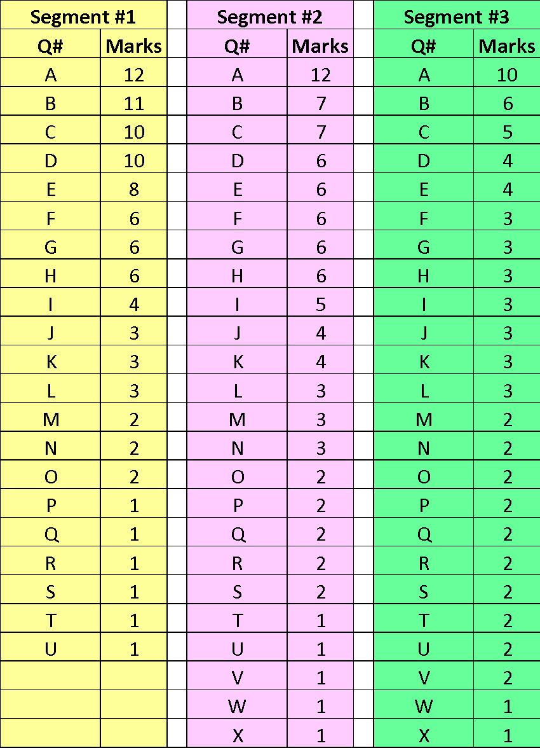
Final Exam Parameters and Format:
Questions and Marks for Each Segment:
The Table listed to the right is for the 2021S Final Exam and may change for this Final Exam.
This information will be made available when you begin each segment of the final exam on eClass.
Questions are NOT worth ALL the same marks. Some questions are worth 1 mark, other questions are worth 12 marks. The allotted time and grade weight are based on the total marks in each segment, NOT on the number of questions.
For the three segments, the question labels do NOT appear and the order of questions will be different than listed here.
The questions as listed are ranked by marks, highest to lowest.
Expectations and Instructions For Writing the Final Exam
‹#›
Notes:
‹#›

Slide 17
Final Exam Content and Your Preparation:
Studying:
Study as though you have no access to any resources
during the Final Exam i.e. as though it were “closed book”.
Anyone who does not study and intends to rely on using
available resources to find information in response to the
questions will be woefully unprepared and will not perform well.
Prepare for the final exam as efficiency will be required to complete it in the allotted time.
Precious time can be consumed “searching for the answer”.
Case Studies:
Know details about the course case studies as well as your team project case study.
I will not ask specific details about course case studies
i.e. I won’t ask “When did the Loss Incident occur?”
But you will be expected to apply key principles, practices, and lessons of risk management and as derived from those case studies, or any short case study presented in the final exam.
Expectations and Instructions For Writing the Final Exam
‹#›
Notes:
‹#›

Slide 18
Final Exam Content and Your Preparation:
Calculations:
Have a calculator (or spreadsheet) for basic arithmetic calculations (+-x/).
There are several questions with calculations presented in lectures.
Memorize:
There is very little to memorize.
Example: “What are the four key points of the Engineer’s Survival Guide?”
Critical Thinking and Application:
You will be expected to apply the knowledge you know AND your critical thinking skills to answer the questions.
The final exam is cumulative:
In order to master lecture content in the latter part of the term, one should be competent in the content covered prior it. The final exam draws on content from the entire term.
IF you are regularly attending and engaging yourself, THEN there will be no surprises!
Expectations and Instructions For Writing the Final Exam
‹#›
Notes:
‹#›

Slide 19
Final Exam Content and Your Preparation:
Final Exam Questions:
Similar in nature to the assignments:
  Written responses (open text boxes) if any – spelling is not graded
  Numerical responses – observe number format as described in the question
  Multiple choice letters / drop-down / pick-list
  What you enter is what you are graded on – rough work not counted so photos or scans of your work are NOT needed
    For MOST questions, there is no penalty for an incorrect response.
    Please be aware that a penalty does apply for incorrect
    responses on some multiple-choice questions.
    These are specifically noted on each question.
    No response = no marks earned, no penalty
    The number of questions on the exam is immaterial.
    What is important … the exam is 180 minutes in duration
    at ~1.4 marks earned per minute, for about 260 marks +/- total.
Expectations and Instructions For Writing the Final Exam
‹#›
Notes:
‹#›

Slide 20
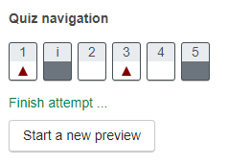
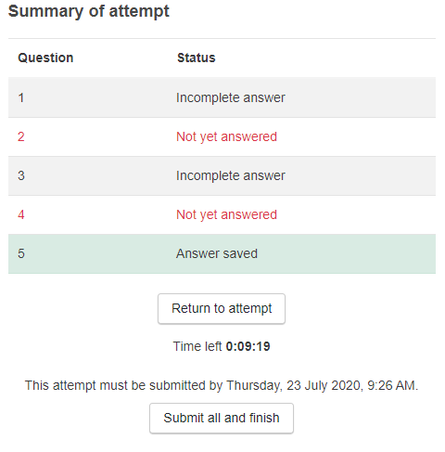
Key Points about Writing the Exam:
Quiz Tools and Tips for Students – see eClass page:
https://support.ctl.ualberta.ca/index.php?/Knowledgebase/Article/View/371/10/quiz-tools-and-tips-for-students
Quiz Navigation and Summary of Attempt:
To navigate within the exam, look in the upper
left corner for the “Quiz Navigation” grid:
  “Free Navigation” allows you to move
  to any question.
  “Sequential” segments allow you to
  advance to the next question ONLY if you
  have responded to the current question.
Select “Finish attempt” to submit. Before it
submits, the “Summary of attempt” lists the
responses to all questions on the exam:
  “Incomplete answer” means that you have
  not yet attempted that question.
  “Answer saved” does not mean that it is
  correct or complete in all respects.
  You can either “Return to attempt” or
  “Submit all and finish”
Expectations and Instructions For Writing the Final Exam
‹#›
Notes:
‹#›

Slide 21
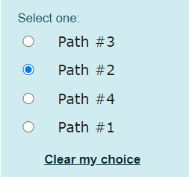
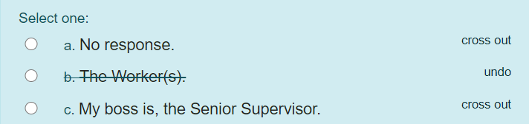
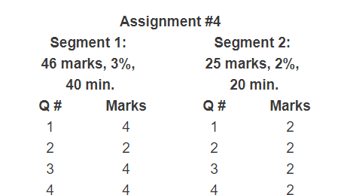
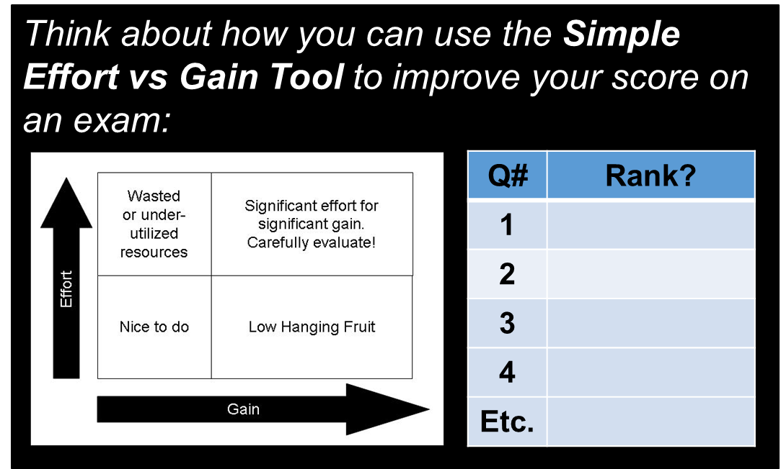
Key Points about Writing the Exam:
Managing Your Time:
Use the “clear my choice”
and “cross out” features
to help you choose your
response on multiple
choice questions:
A list of question numbers and the marks
will be provided prior to the Final Exam.
  Check eClass Final Exam section
You may wish to “risk rank” and
prioritize your questions:
  👍 👎 ☞
  ☑ ☒ ?
Expectations and Instructions For Writing the Final Exam
‹#›
Notes:
‹#›

Slide 22
Self-Reflection: Final Exam Content and Your Preparation:
Q: When should you start studying for the Final Exam?
Most of this content comes naturally to me through work-term experience, so I plan to spot-study a few days before the final exam.
This is new content to me, so I need to study perhaps 1 to 3 hours per week throughout the course in order to learn and apply the content.
Most of this content comes naturally to me through work-term experience, so I plan to spot-study a couple of hours each week throughout the term.
I plan to cram the night before.
It’s “open book” so I don’t need to study.
Expectations and Instructions For Writing the Final Exam
‹#›
Notes:
‹#›

Slide 23
Do You Have Questions?
This presentation contains many details about the final exam.
Questions of a general nature about the form and format of, or
content covered in the Final Exam can be answered from the
content of this presentation, so please review this before asking
questions.
Those with conflicts or accommodations have been notified. If you have NOT been notified, please contact Professor Cocchio immediately. Cocchio@ualberta.ca
If you have a question of a personal nature e.g. “I have not yet resolved the conflict with another final exam”, please send an email to your instructor and cc Professor Cocchio; ensure the subject line starts with:
“ENGG404 2022S – Question on Final Exam / Resolve Conflict”
Expectations and Instructions For Writing the Final Exam
‹#›
Notes:
‹#›

